Slide 1
"Achieving abundant health in a toxic world and hostile medical system"

Slide 2
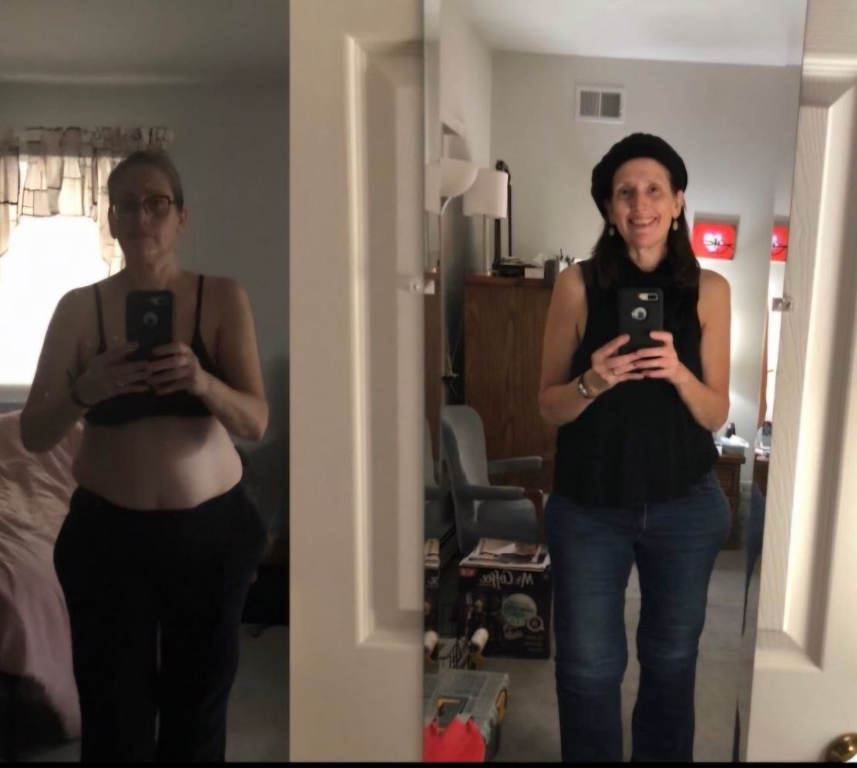

Curing incurable diseases
Elizabeth Glass healed lymphedema
Lost 60lbs
Lives a fully functional life

Slide 3
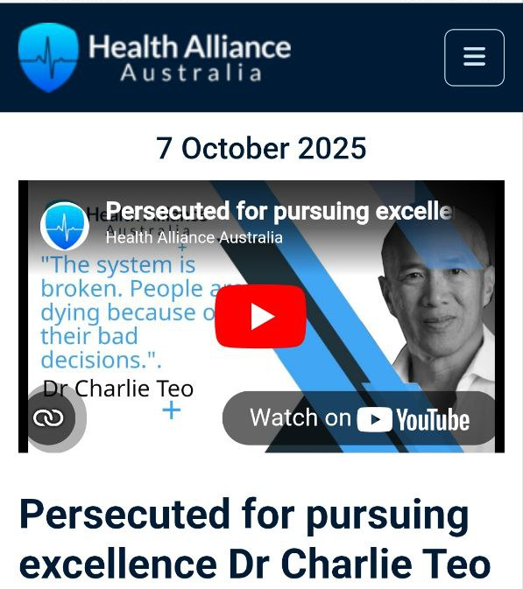
Interview Dr Charlie Teo
One of the top brain surgeons in world banned operating in Australia
“If you step outside the box. If you offer contrary second opinions. Then we will get you. Because if we can get Charlie Teo. We can get anyone.”

Slide 4
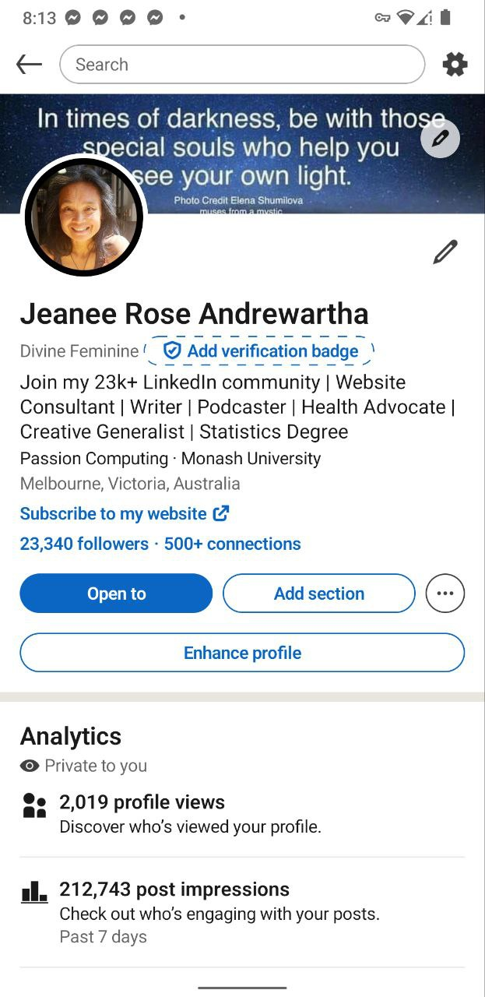
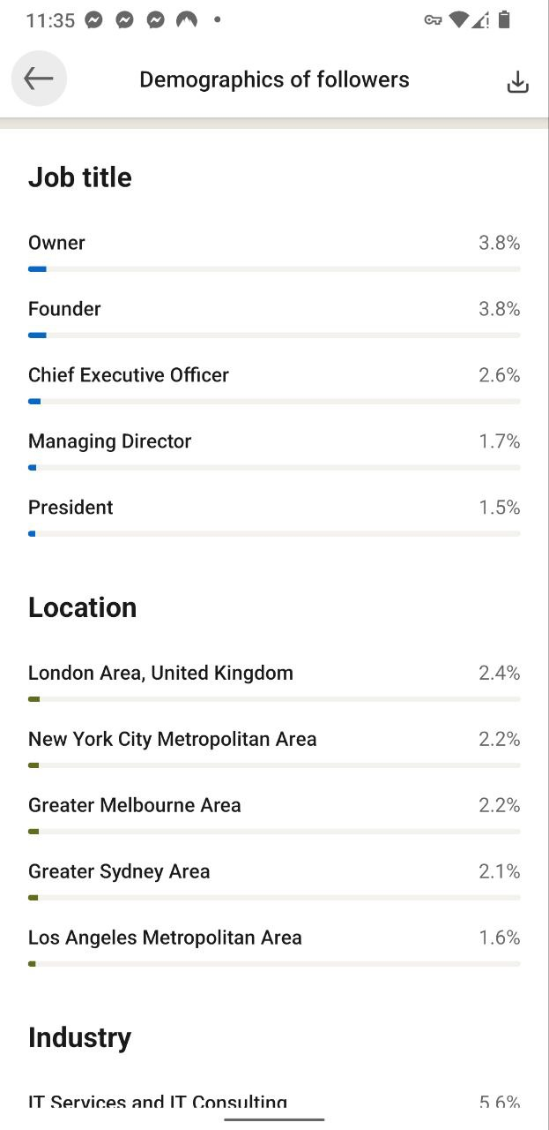
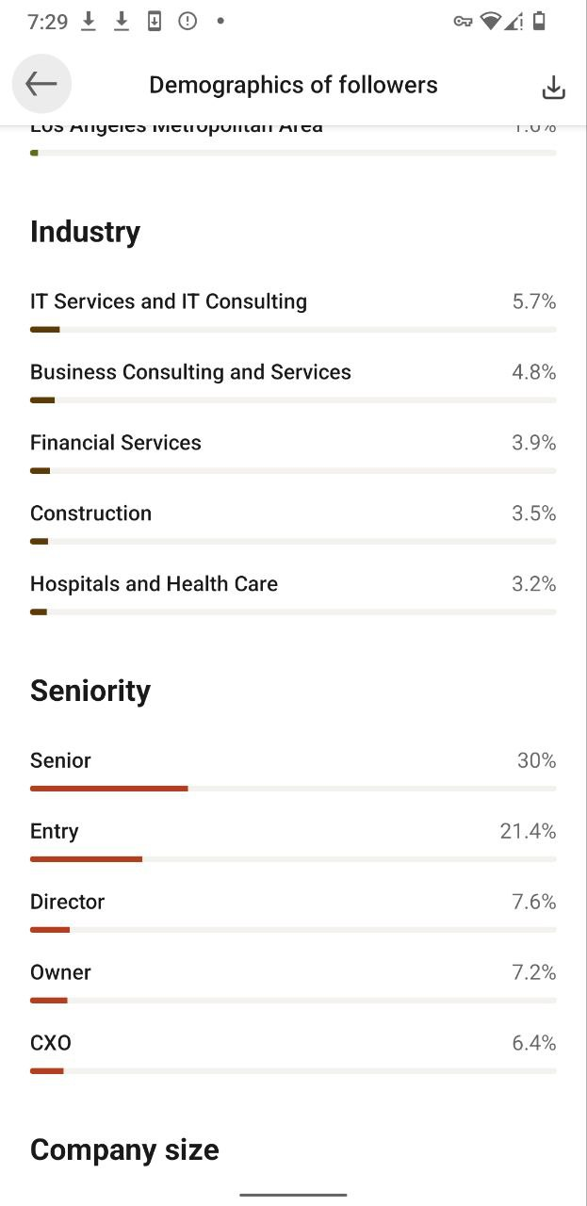

Slide 5
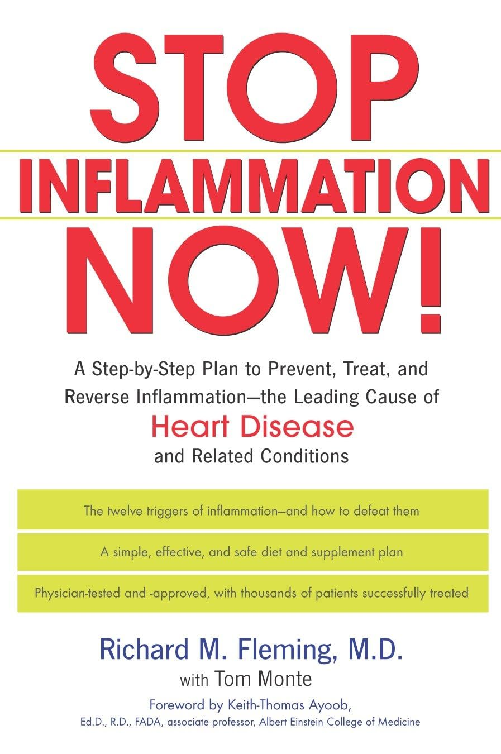
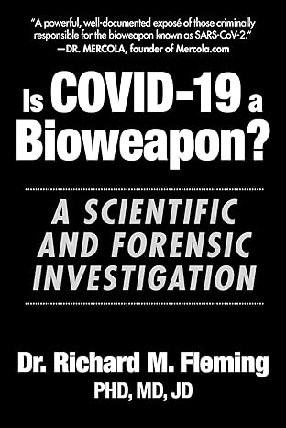
Notes:
Dr Richard Fleming "You are designed to survive"
SARS-COV-2 can reverse transcribe and get into your DNA Presented a framework of understanding COVID19 and how to heal from the shedding, infection and the injection/jab based on measurable scientific research.

Slide 6
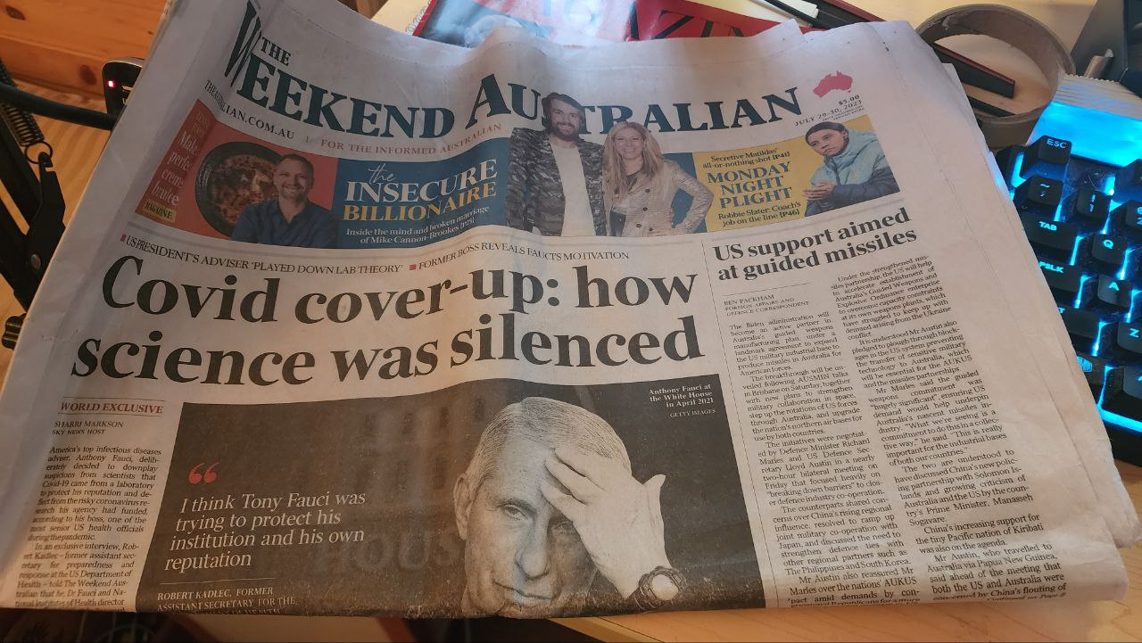
The Australian October 2023

Slide 7
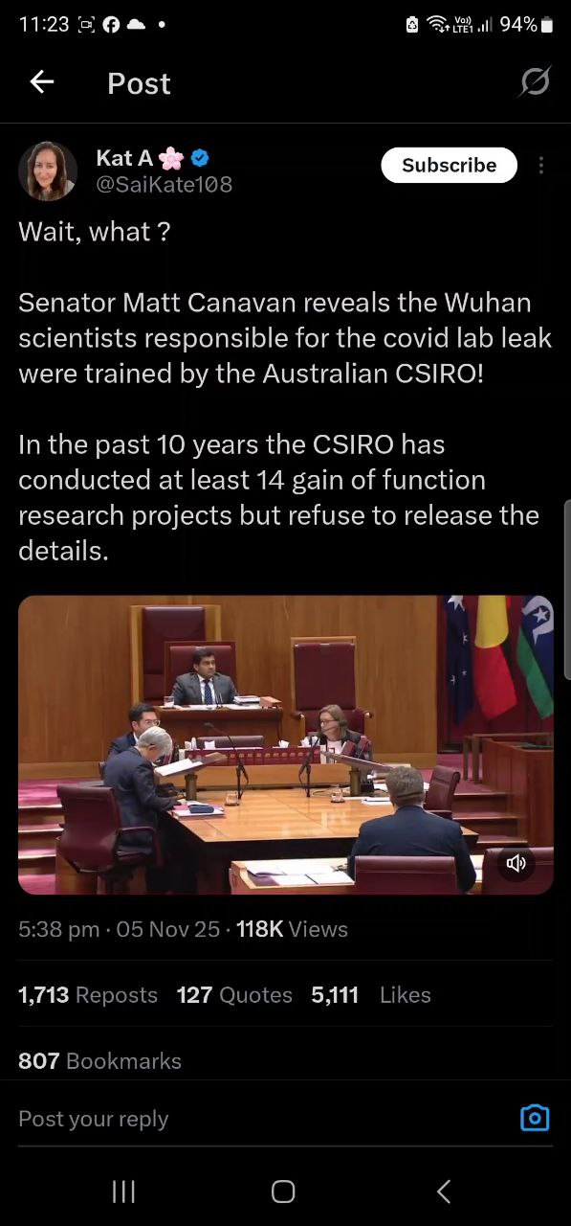
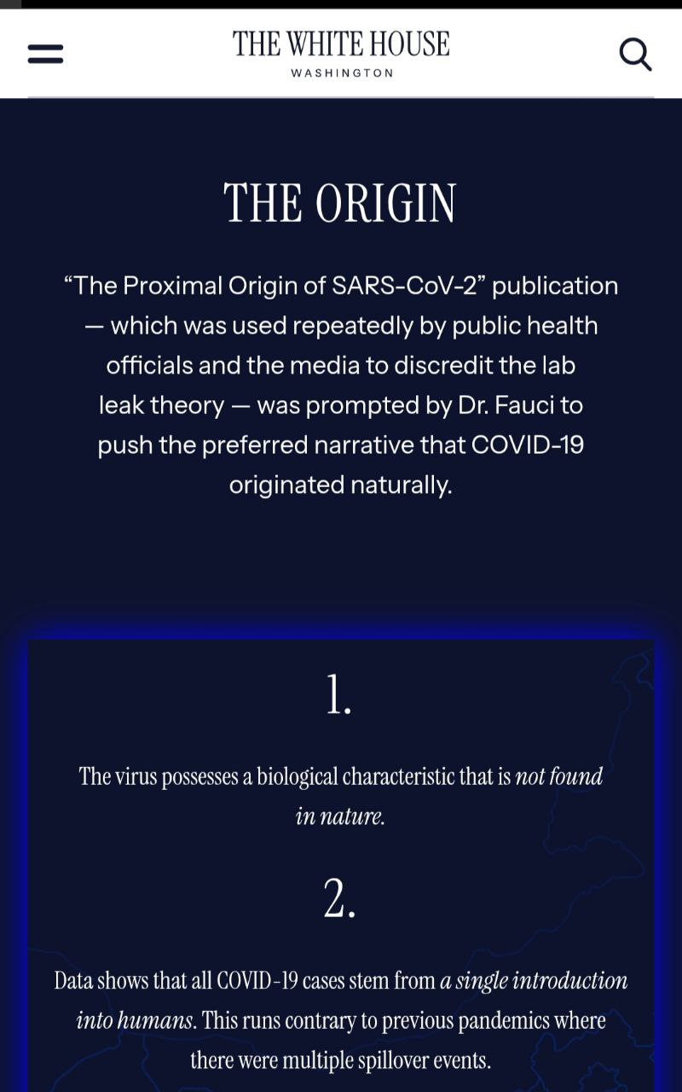

Slide 8
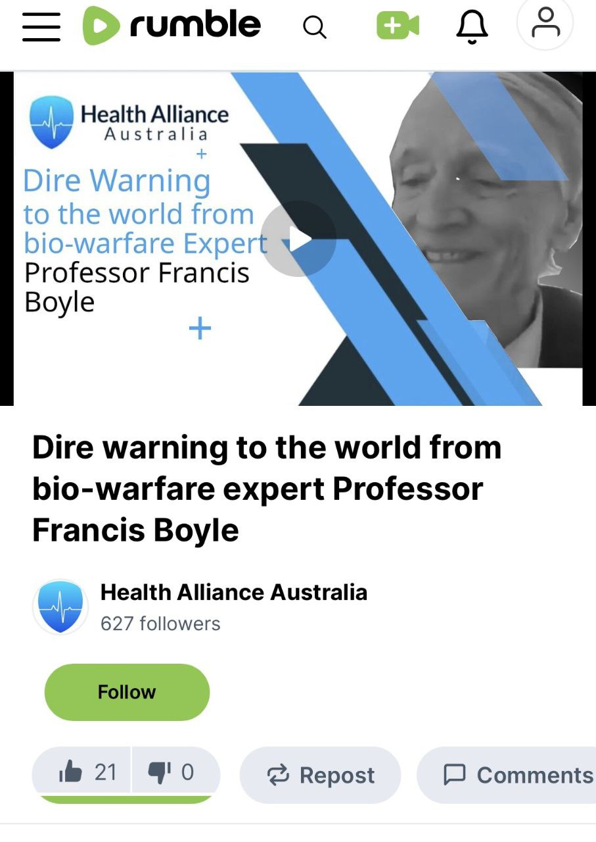
"We are in the fight for our lives" Prof Boyle
Professor Francis Boyle drafted the S.993 – Biological Weapons Anti-Terrorism Act of 1989
According to Professor Francis Boyle all BSL-3 and BSL-4 labs need to be shut down immediately. They serve no purpose but to develop offensive biological weapons.
He says the Frankenstein shots are a Nuremberg crime against humanity.
First to interview him in Australia Felony imprisonment produce bioweapons on US soil. He named key figures involved, including UNC, Wuhan, Fauci, Daszak, and Baric.
Mysterious found dead agreed to testify against Fauci and Bourla

Slide 9
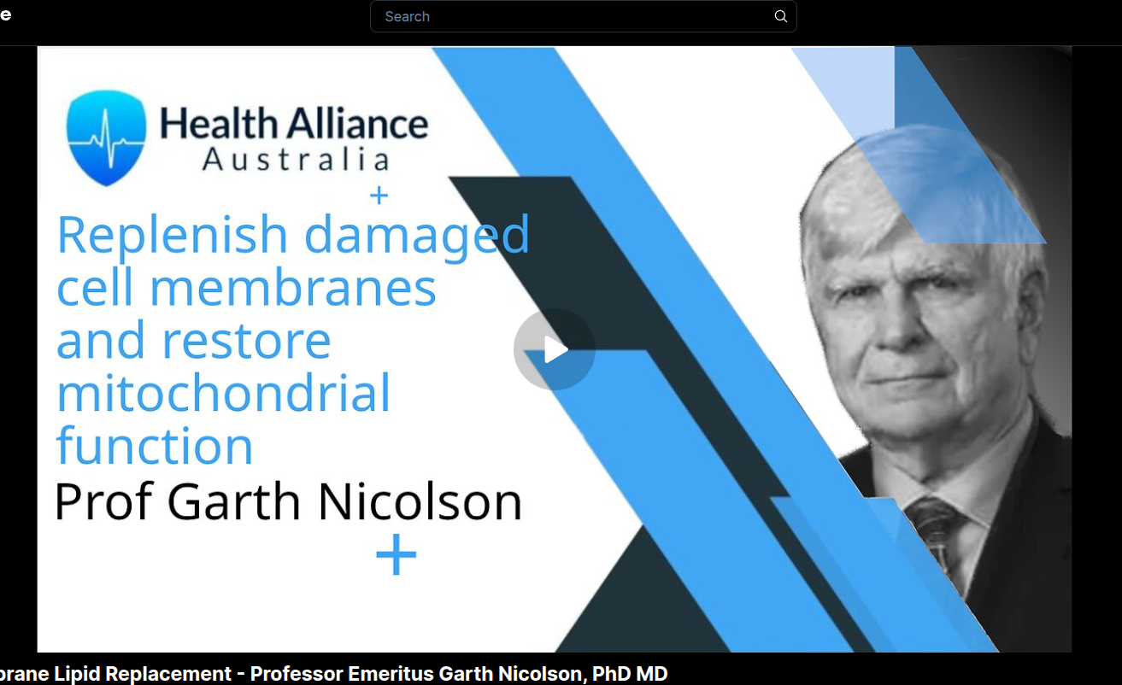
BIOWEAPONS TESTED ON TEXAS PRISONERS
Prof. Emeritus Garth Nicolson, PhD, MD is a world authority with a very impressive list of achievements and knowledge. In ScholarGPS International Rankings (2025), he ranks #1 Cell Membranes, #2 Cancer Metastasis, #13 Tumor Progression, #53 Cell & Molecular Biology. Prof Nicolson, also wrote the book. The Project Day Lily story chronicles the events surrounding what the public knows as "Gulf War Syndrome."
To this day, the public perception of that tragedy is very limited, but now there are over 150,000 veterans of that conflict that suffer from chronic illnesses and tens of thousands have died without acknowledgment or proper assistance to keep secret the origin of their illnesses. A biowarfare program.

Slide 10
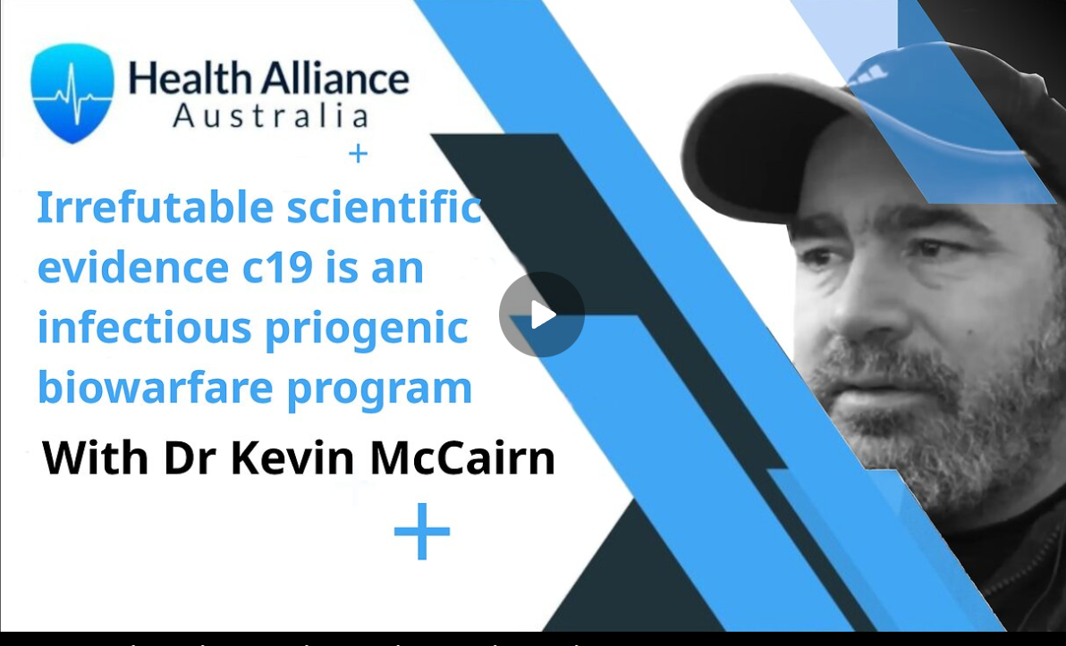
Warning: Global amyloidogenic health disaster
Neurological disease
Cancer
Heart disease
Stroke
Multi organ dysfunction
Sudden death
All manner of disease

Slide 11
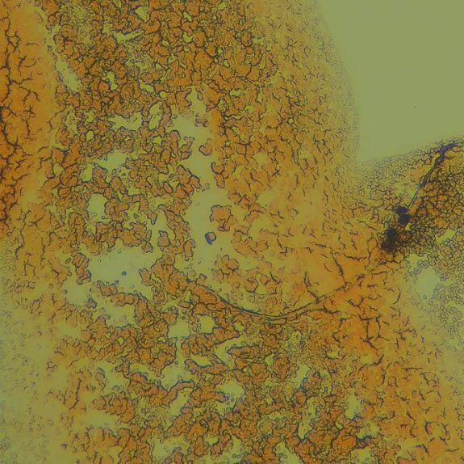
RT-QuIC and Raman Spectroscopy Confirmations in Embalmer White Clots
The embalmers fibrous white clots were analysed under the microscope at low to high magnification and observations discussed. Very abnormal structural properties were observed that are consistent with protein misfolding and staining these samples also confirmed the result that it is misfolded fibrin.
We discuss his analysis of unusual fibrous white clots, retrieved from the deceased and how he determined their composition to be diseased, proteinaceous tissue; primarily misfolded fibrin that is highly amyloidogenic.
Ninety percent of blood sent to Dr Kevin McCairn have these amyloidogenic peptides

Slide 12
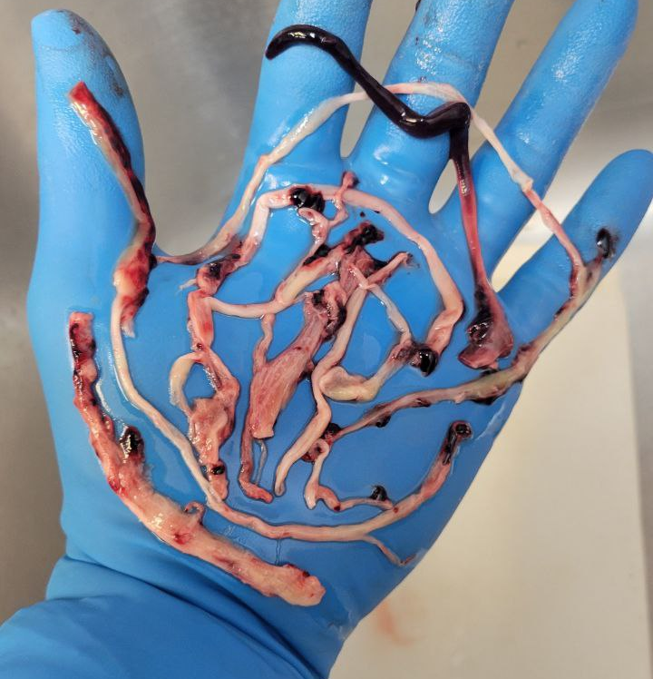
Embalmer Richard Hirshman
"My first 20 years of embalming, I never seen anything like this. Why do I share this? Because you have a right to know that it's happening!
Maybe it explains why so many people are suffering from vascular issues, heart issues, strokes and aggressive cancers! Not always are these clots as large as others, but it is the white fibrous material that's not normal!
Blood clots are normally red and jelly like."
THIS IS THE SMOKING GUN

Slide 13
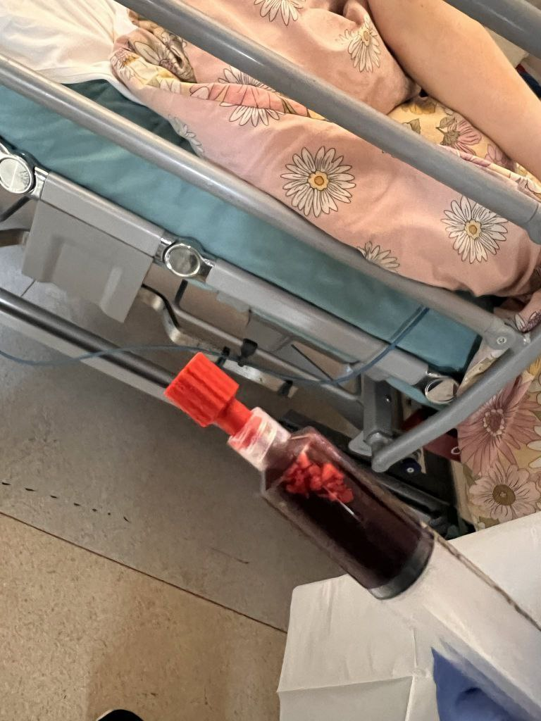
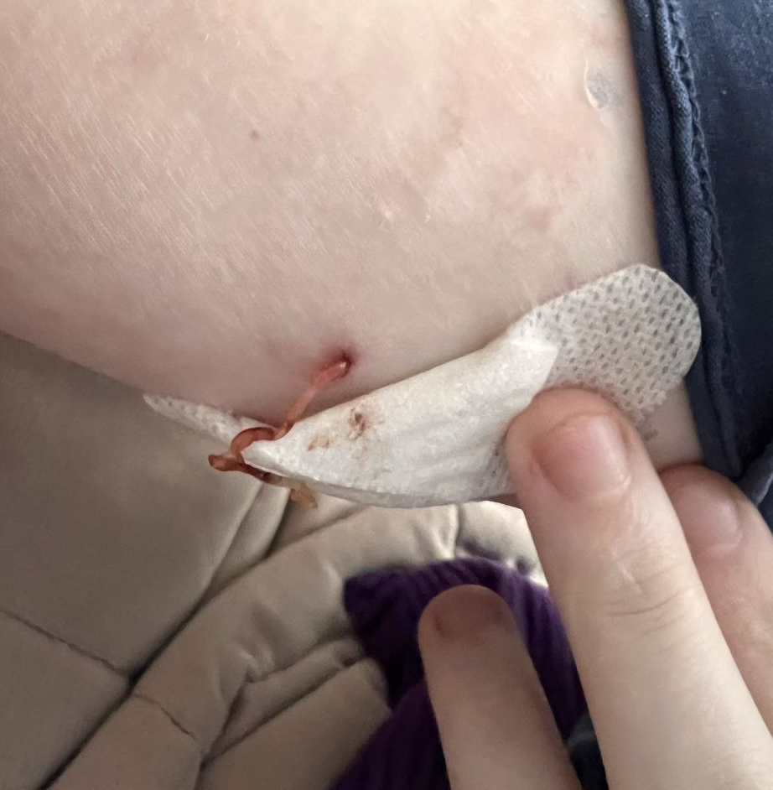

Slide 14
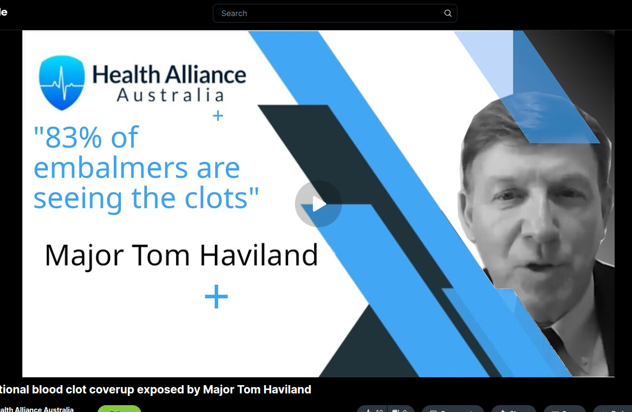
Intentional blood clot coverup exposed by Major Tom Haviland
Major Tom Haviland formed a database of 1,700 embalmers and Spoke in person 8th June 2025 Funeral directors Association Franklin, Tennesee
"83% of embalmers seeing these clots"
The results of Tom’s surveys are shocking and disturbing but also confirm the laboratory findings and tie into our previous interviews with Dr Kevin McCairn and Elizabeth Glass.

Slide 15
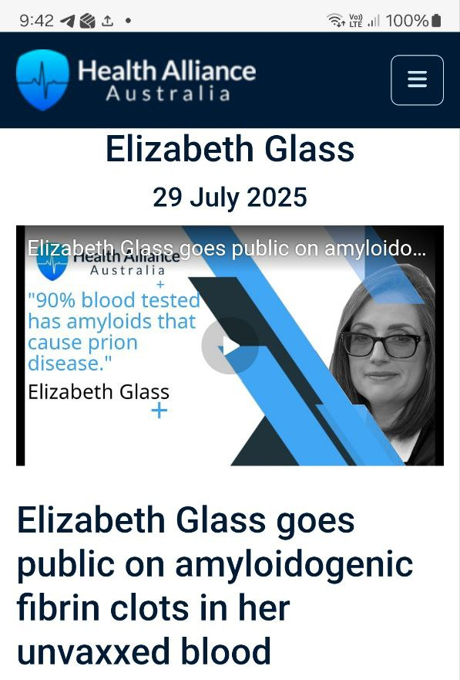
Elizabeth had 3 samples tested with Dr Kevin McCairn. All three tested positive for amyloids
Unvaxxed herself, unvaxxed son, vaxxed relative

Slide 16
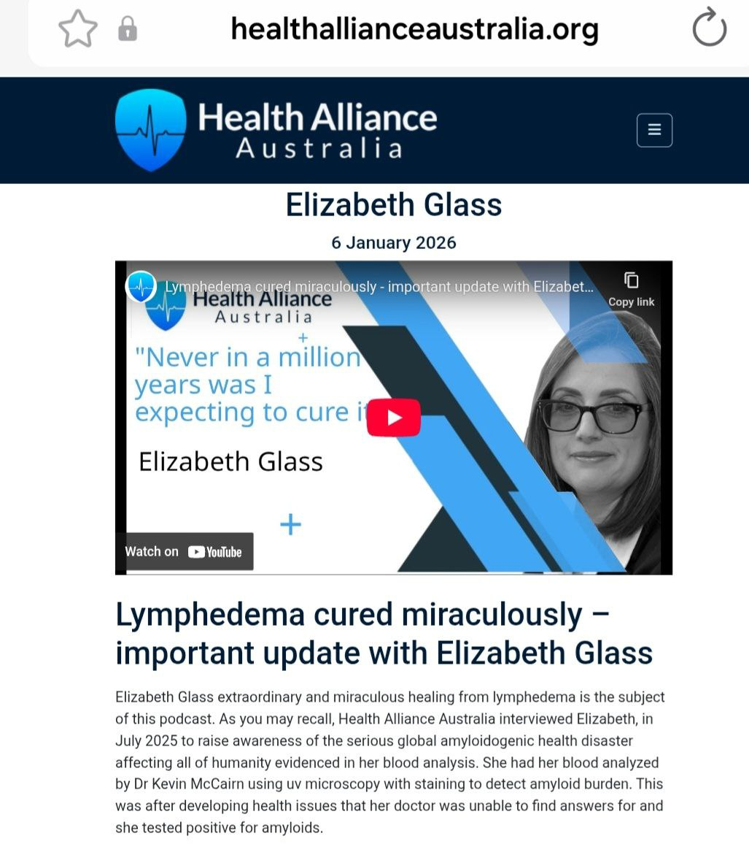
Elizabeth Glass
Lyphedema correlated to amyloidogenic fibrin
Elizabeth cured her lyphedema – lost 60lbs, switched plant based wholefood (Eden diet)
7 day water fast.
Now done a 28 day water fast.
Body has an amazing ability to heal.

Slide 17
Summary of what I learnt healing
Toxins stored in the fat
Gut health is critical
Nutrition is essential
Reduce toxins exposed to
Keep histamines low
Reduce cortisol and stress
Maximize Detoxification
Removal waste body
Exercise
Sunshine and sleep
Breath and Nature
Good water
Mental/emotional wellbeing
Community

Slide 18
Latest Research for to remove amyloids
This is experimental.
Dr. McCairn's has successfully used apheresis to filter blood on 8 long Covid/long vax patients.
Result: So far improvement sustained >6 months after treatment. Through the jugular vein, dual-filtration plasma apheresis removes diseased parts & returns cleaned plasma (the yellowish part of the blood). Then he adds stem-cell growth factors, shown in test-tube studies to prevent new amyloid clots (misshapen protein clumps) from forming. Plasma contains protein & antibodies.
Very expensive and not available in Australia.

Slide 19
Is extended water fasting is the cure?
Detoxification
Autophagy, or "self-eating," is a vital, evolutionarily conserved catabolic process in which eukaryotic cells degrade and recycle their own damaged, dysfunctional, or unnecessary components (proteins and organelles) via lysosomesa
Water fasting (typically 24–72 hours) triggers stem cell-mediated regeneration by inducing a "fasting-refeeding" cycle that activates cellular repair.
Prolonged water-only fasting significantly increases human growth hormone (HGH) levels, with studies showing surges of up to 1,225%.
vital, evolutionarily conserved catabolic process in which eukaryotic cells degrade and recycle their own damaged, dysfunctional, or unnecessary components (proteins and organelles) via lysosomesa vital, evolutionarily conserved catabolic process in which eukaryotic cells degrade and recycle their own amaged, dysfunal, or unnecessary components (proteins and organelles) via lysosomes

Slide 20
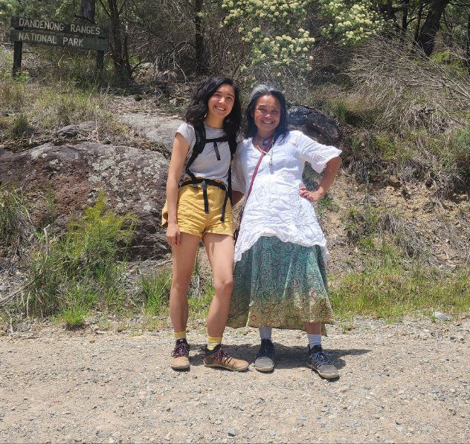
Healed cardiomyopathy
Completed 75 Hard Challenge
19 day water fast
Hike Moderate to difficult trails
Took up tap dancing
Walk 15+ kilometres
Live a busy and active life

Slide 21
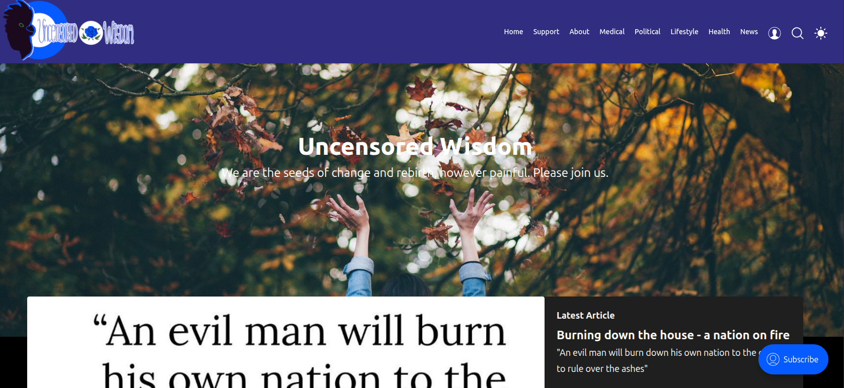

Slide 22
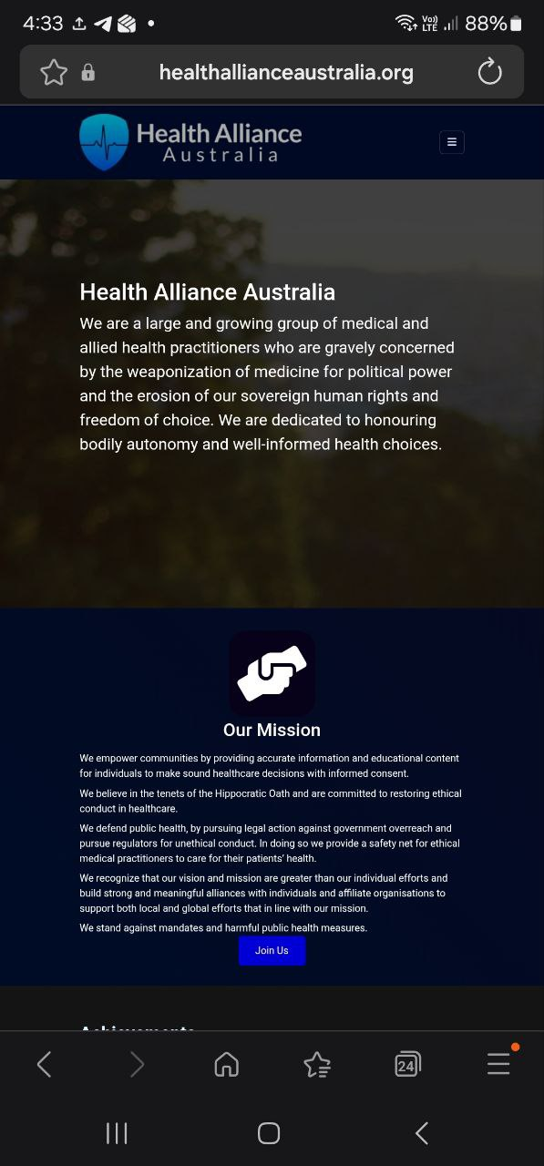
Health Alliance Australia
We raise awareness and provide educational material on health but we can’t do it without your support!
Critically important educational material on health

Slide 23


